Slide 1
DengAI: Predicting Disease Spread
Professor:
Dr. Lawrence V. Fulton
Team Members
Ratnam Dubey

Slide 2
Competition Details
Content
Impact of Solution
First Look at Data Exploratory Data Analysis Model Formulation Challenges and Learning

Slide 3
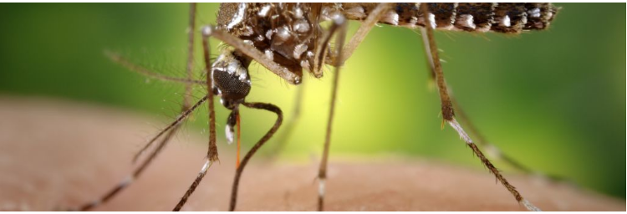
Competition Details
Dengue fever is a mosquito-borne disease that occurs in tropical and sub-tropical parts of the world. In mild cases, symptoms are like the flu: fever, rash, and muscle and joint pain. In severe cases, dengue fever can cause severe bleeding, low blood pressure, and even death. Because it is carried by mosquitoes, the transmission dynamics of dengue are variables such as temperature and precipitation. Although the relationship to climate is complex, a growing number of scientists argue that climate change is likely to produce distributional shifts that will have significant public health implications worldwide.

Slide 4
Impact of Solution
Better Prediction of the Cases of Dengue in the given areas
Increase disease based medicinal research.

Slide 5
First Look at Data
The datasets we used in our project came from an on-going Driven Data (source: https://www.drivendata.org/competitions/44/dengai-predicting-disease-spread/) competition. Data has been provided in below files: -
1) Train features
2) Sample Submission Files
3) Test Features
4) Train Labels

Slide 6
Details of Data Set Provided
We need to predict the total cases for the given cities. Information need to be Extracted from the train labels and features files. With the help of R Script, we have extracted the features from the all the training and test data. Data extracted from the dcm files have columns like
1. city
2. year
3. weekofyear
4. week_start_date
5. ndvi_ne
6. ndvi_nw
7. ndvi_se
8. ndvi_sw
9. precipitation_amt_mm
10. reanalysis_air_temp_k
11. reanalysis_avg_temp_k
Variables are only in integers.

Slide 7
Exploratory Data Analysis(EDA)

Slide 8
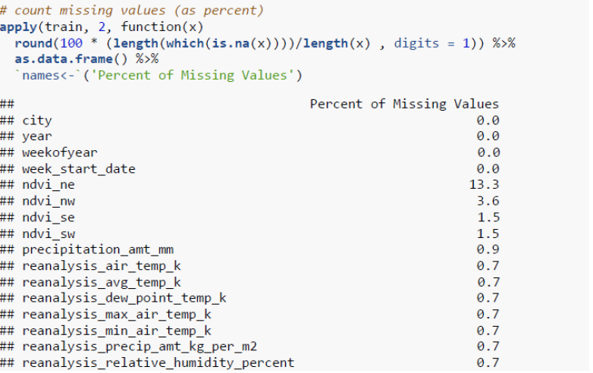
Considering the datasets this shows that the dataset is incomplete and there is need to clean it from empty entries’. Infect every column except State , Date and Date of year all the values are missing some are in greater quantity some in less replaced the missing values with the mean value to maintain the data integrity.
Missing Values

Slide 9
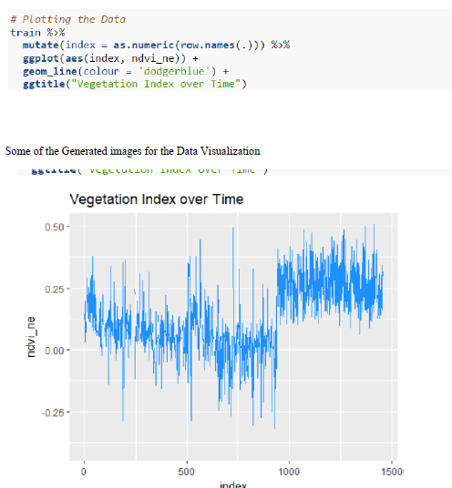
Data Visualization

Slide 10
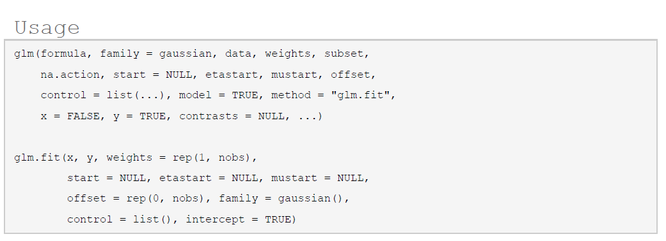
Glm is used to fit generalized linear models, specified by giving a symbolic description of the linear predictor and a description of the error distribution.

Slide 11
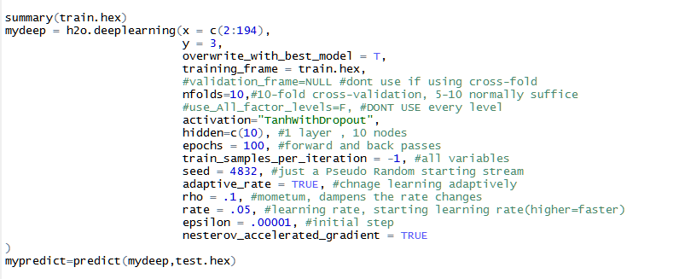

Slide 12
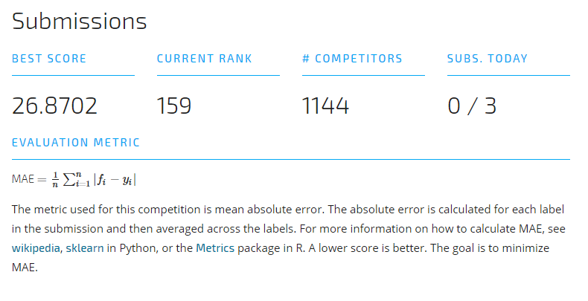
Prediction Result

Slide 13


Challenges And Learnings

Slide 14
References
✓ XGB Boosting Machine- https://www.rdocumentation.org/packages/h2o/versions/3.10.0.8/topics/h2o.gbm
✓ Build A Big Data Random Forest Model- https://www.rdocumentation.org/packages/h2o/versions/3.10.0.8/topics/h2o.randomForest
✓ https://www.analyticsvidhya.com/blog/2016/05/h2o-data-table-build-models-large-data-sets/
✓ https://www.analyticsvidhya.com/blog/2016/05/h2o-data-table-build-models-large-data-sets/
✓ https://www.datarobot.com/blog/XGB-boosted-regression-trees/
✓ http://scikit-learn.org/stable/auto_examples/linear_model/plot_logistic_l1_l2_sparsity.html
✓ http://scikit-learn.org/stable/modules/preprocessing.html

Slide 15
Thank You

